Slide 1
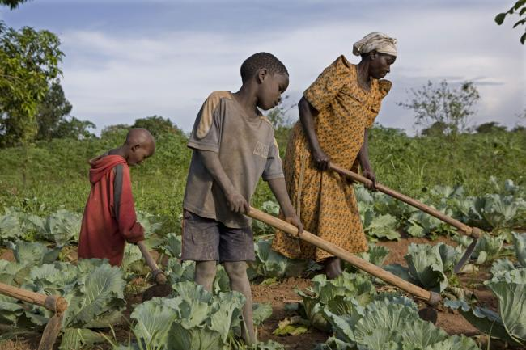
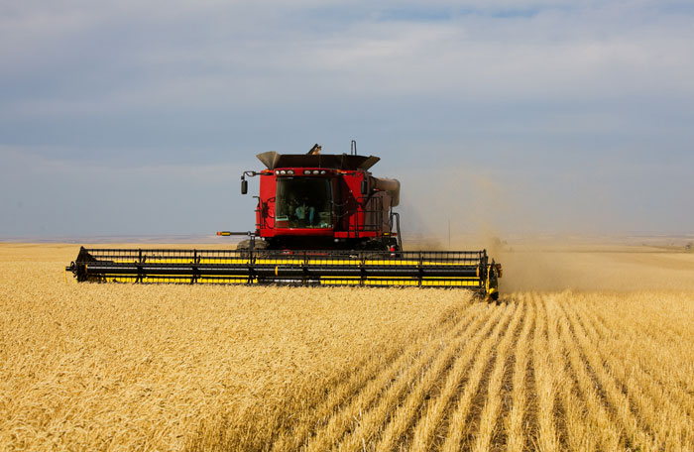
Topic 5.2: Terrestrial food production systems and food choices
Starter:
What are the differences between subsistence farming and commercial farming?

Slide 2
Definitions
LEDC – Less economically developed country
MEDC – More economically developed country
Agribusiness – All business associated with agriculture
Commercial agriculture – large scale production of crops and livestock for sale
Subsistence agriculture – farming for self-sufficiency to grow enough for a family

Slide 3
Think About It
Even though our world produces enough food for everyone, about one in eight of us still goes to bed hungry each night. to bed hungry each night.
What are some of the reasons that people go hungry?
Can you name some places in the world where people are experiencing hunger right now?
What are some specific things we as individuals can do to help end hunger for others, locally and globally?

Slide 4
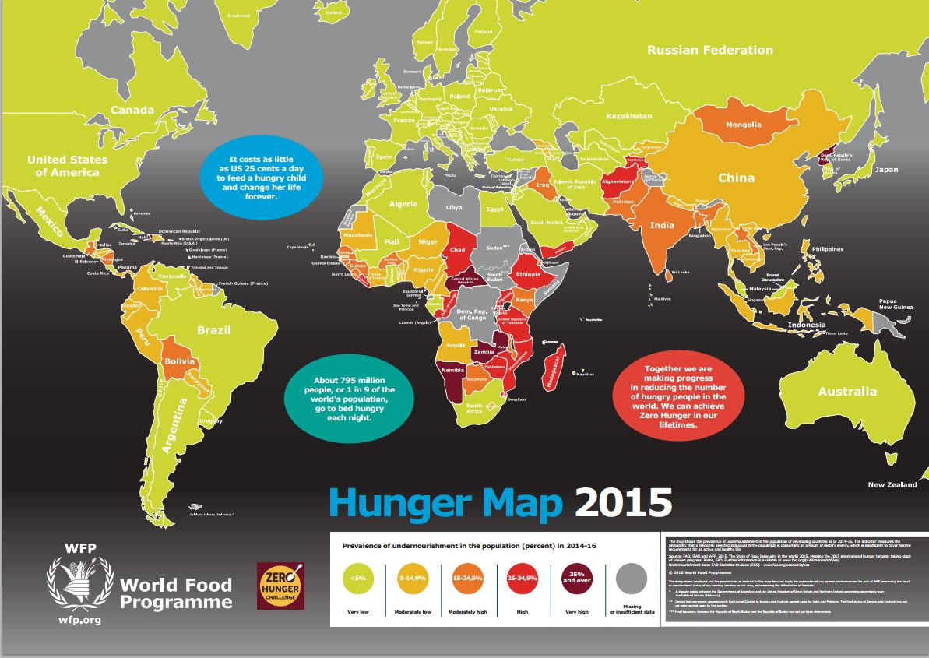

Slide 5
What is the Problem
870 million people (1 in 8) suffer from chronic undernourishment (deficiency of calories and protein) worldwide
Poor nutrition plays a role in at least half of the 10.9 million child deaths each year

Slide 6
What is the Problem
The world produces enough food to feed every person on earth (actually in excess) however it is lack of transportation, access to land, water, and money to distribute this food that creates the shortages
Poverty, harmful economic systems, conflict, and climate change all contribute to the problem

Slide 7
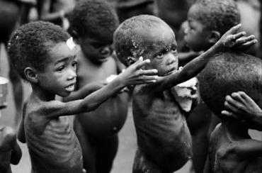
Inequalities
¾ of the world is inadequately fed with about 1 billion going hungry
Too much food is being produced in MEDCs leading to surplus and lowered price of food.

Slide 8
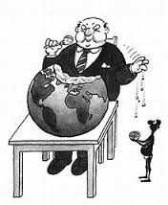
Inequalities
Some MEDCs have import tariffs which make the import of food more expensive.
LEDC food production is often used as a way to generate foreign income from cash crops leading to an emphasis on export, rather than feeding the local populations

Slide 9
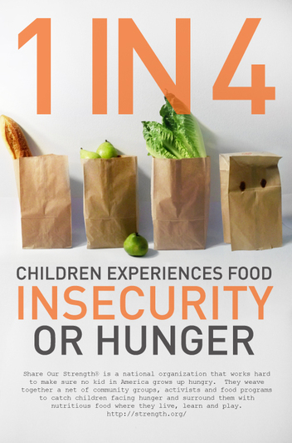
Inequalities
Long-standing imbalance between rich and poor countries in international agricultural trade.
Domestic support and export subsidies to farmers in MEDCs make LEDC crops uncompetitive.

Slide 10
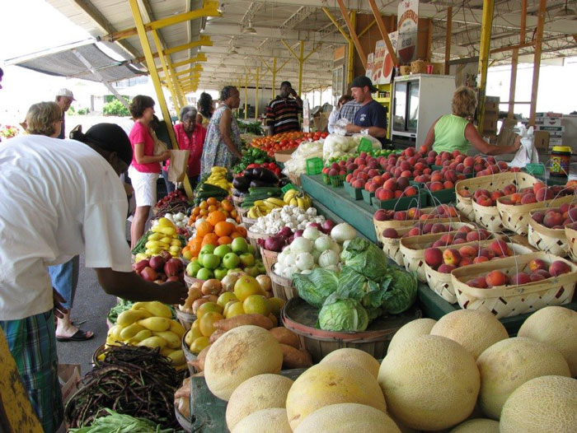
Inequalities
Increased meat/dairy consumption and biofuel use pushes prices up as land isn’t used for food crops.
Climate change with higher temps in tropical and subtropical areas can lead to crop loss.

Slide 11
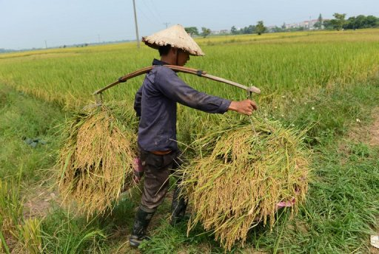
Inequalities
MEDC farms are very technocentric, whereas LEDC farms are very labor intensive (usually from within the family.)

Slide 12
Using the table to answer the following question
Explain why subsistence farming could be considered more sustainable than commercial farming? (6)

Slide 13
 | Which is more sustainable?
Factor | Commercial farming: most in MEDCs | Subsistence farming: mostly in LEDCs
Agribusiness
Scale of farming
Industrialisation
Mechanisation
Fossil fuel use
Seed/crop/livestock choices
Water use
Fertilisers, pest control
Antibiotics
Legislation
Pollinators

Slide 14
Farming Systems
Subsistence Farming
  Production food for family
  No surplus
  Human and animal labor
  Mixed crops
  Low inputs of energy
  Cash cropping

Slide 15
Farming Systems
Commercial Farming
  Production for profit
  Maximizing yield
  High level of technology
  Monocultures
  High inputs of energy
  Extensive- more land with lower planting
  Intensive – use land more intensively

Slide 16
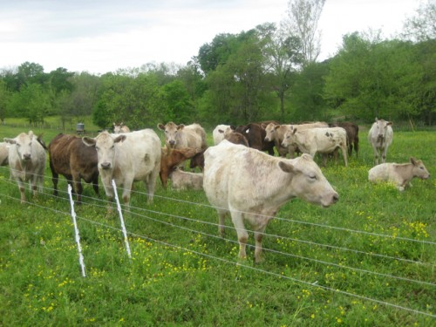
Farming Systems
Pastoral Farming
  Raising animals on grass and land not suitable for crops suitable for crops
Arable Farming
  Growing crops on good soil to eat directly or feed to animals

Slide 17
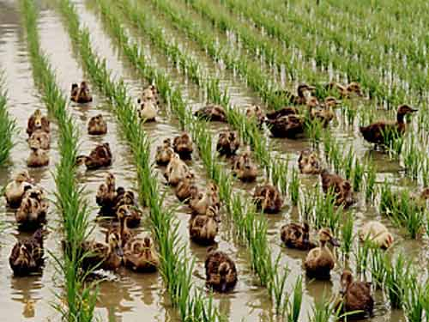
Farming Systems
Mixed Farming
  Crops and animals
  Animal waste used to fertilize crops
  Crops used to feed animal

Slide 18
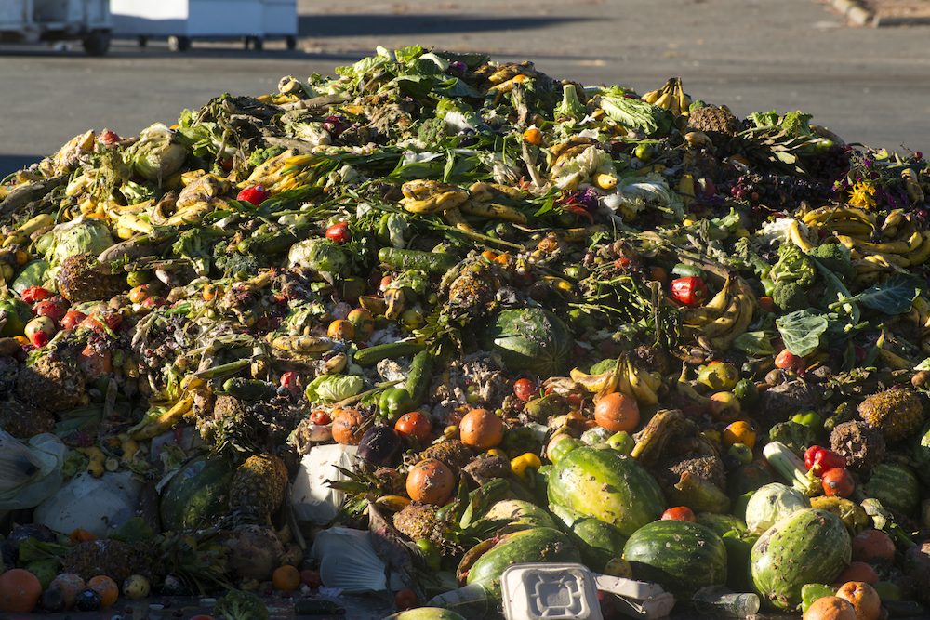
Food waste
http://your.asda.com/news-and-blogs/asda-s-phenomenal-wonky-veg-coming-to-a-store-near-you

Slide 19
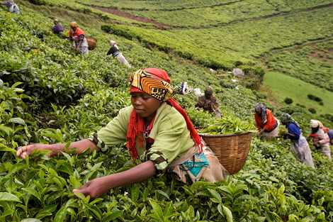
Food is also wasted in LEDCs but for different reasons.
Political, economic agendas e.g. Robert Mugabe, Zimbabwe
Cash crops

Slide 20
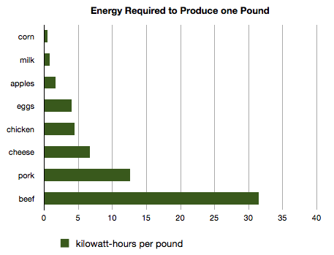

Slide 21
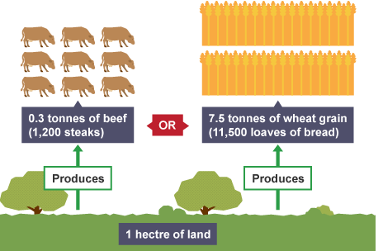

Slide 22
Some cultures prefer to harvest food from higher trophic levels
Western culture – generally primary consumers
Some eastern cultures – dog (secondary consumer)
Other cultures – seals, other aquatic organisms of higher trophic level

Slide 23
MEDC’s vs LEDC’s
Cost of food relatively
Surplus of food stores
Food choice based on preference not nutritional need
Technology and transportation systems allow imports and food produced year round
Struggle to produce enough food for population
Political, economic and environmental limits on food
Food choice determined availability Seasonal
Cash cropping

Slide 24
MEDC’s vs LEDC’s
Average energy intake 3314 calories per day
12.9% from meat
1.4% from fish
37.3% from cereals
Average energy intake 2666 calories per day
7.3% from meat
0.9% from fish
56.1% from cereals

Slide 25
What determines food choices
Climate
  Irrigation and greenhouse
Cultural and Religious influences
  Hindu – no beef, Islam – no pork, Buddhism - vegetarian
Politics
  subsidies and tariffs
Socio-economics
  Supply and demand, affordability

Slide 26
Compare 2 farming systems in detail
Inputs – fertilisers, water, pest control, labour, seed etc.
Outputs – food quality, yield, pollutants, transport, processing, packaging etc.
System characteristics – diversity, sustainability etc.
Environmental impacts – pollution, habitat/biodiversity loss, soil erosion/degredation, desertification, disease etc.
Socio-economic factors – Subsistence/commercial, traditional?, local/export, quality/quantity

Slide 27
Compare 2 farming systems in detail
Some examples:
  Intensive beef production in South American vs. Extensive beef production by Masai tribe in Africa.
  Cereal farming in North America vs. subsistence farming in SE Asia
  You could look at high intensity milk farming in the UK and organic milk production?

Slide 28
Aquatic vs Terrestrial
Terrestrial is a more efficient use of solar energy (1st/2nd trophic level)
Less solar energy reaches aquatic systems (reflection and absorption by water)
Aquatic often higher trophic level (4+)
Aquatic systems more efficient in terms of passing energy along food chain
More skeletal waste in terrestrial (terrestrial animals need more substantial bones to support themselves on land)

Slide 29
How can we be more sustainable?
Population is growing, available agricultural land is decreasing due to soil erosion, salinization, urbanization and desertification.

Slide 30
How can we be more sustainable?
Use the iPads to research the following, find example of each:
Altering human activity
Maximize yield
Local produce
Food Labels
Monitoring multi-nationals
Buffer zones (nutrient run-off)
Food Waste
Changing attitudes about food diets

