Slide 1
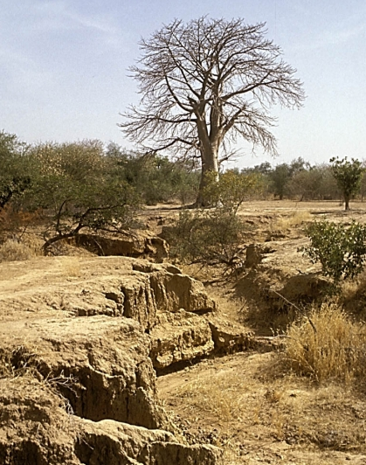
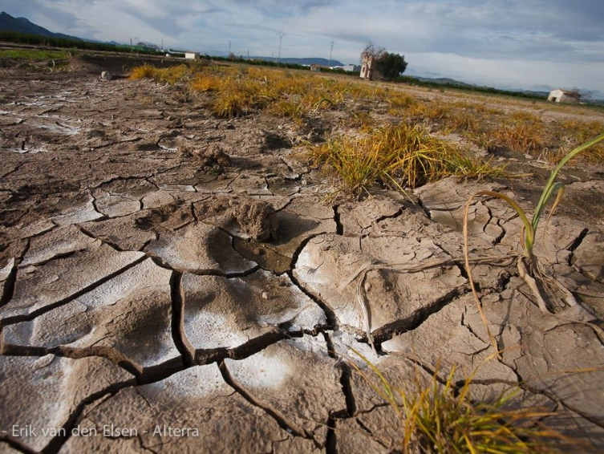
Topic 5.3: Soil degradation and conservation

Slide 2
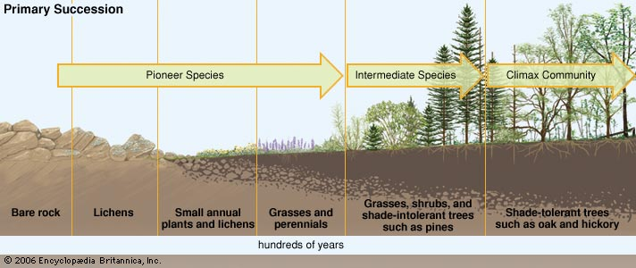
Soil ecosystems change through succession.
Fertile soil contains a community of organisms that work to maintain functioning nutrient cycles.
These communities help keep the soil resistant to erosion.

Slide 3
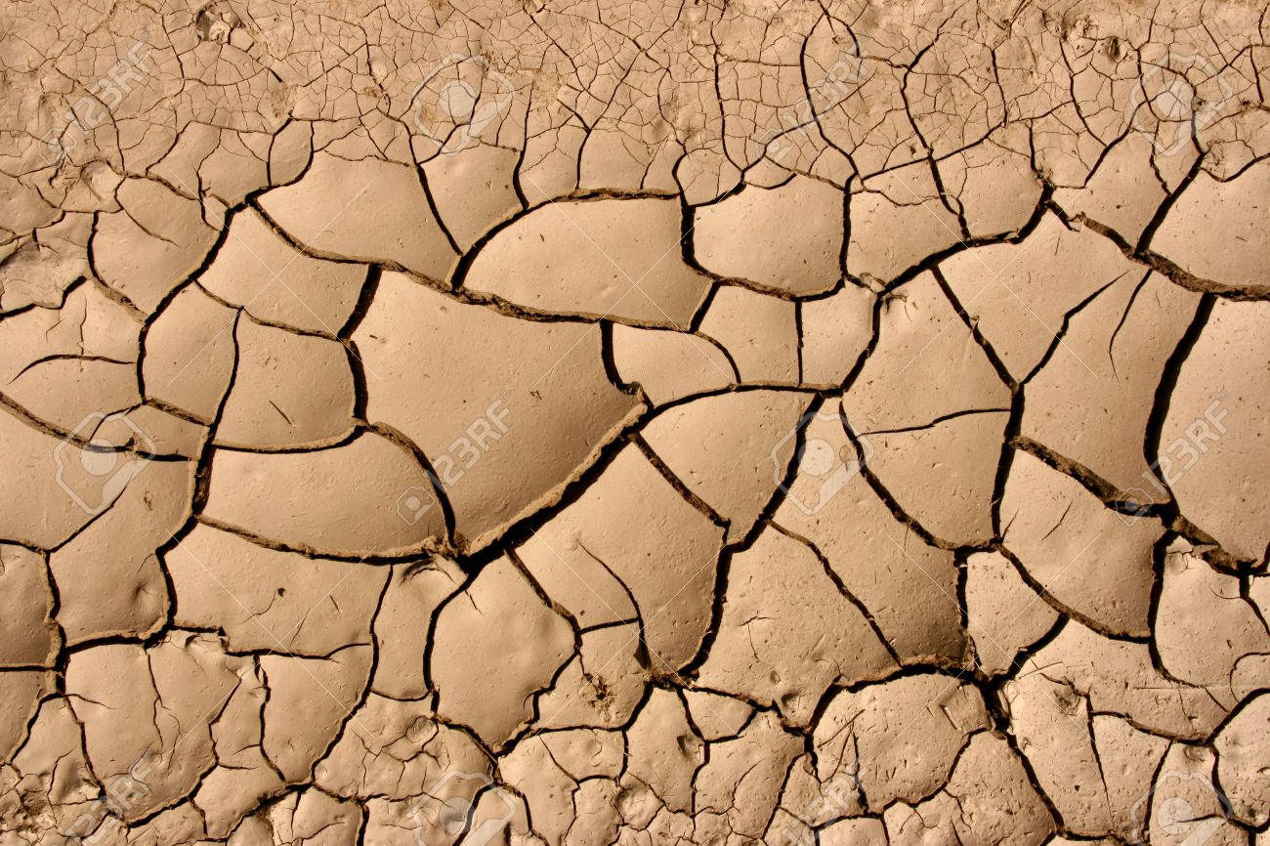
Two main types of process can give rise to soil degradation
Processes that take away the soil (erosion).
  No or little vegetation on the soil.
  Wind and water.
Processes that make the soil less suitable for use.
  Loss of chemicals/nutrients (leaching)
  Addition of chemicals (pollution)
Generally commercial industrialised food production systems reduce soil fertility more than small-scale subsistence farming.

Slide 4
Soil Erosion
Movement of soil, especially surface litter and topsoil
Two main agents of erosion
  Wind
  Flowing Water

Slide 5
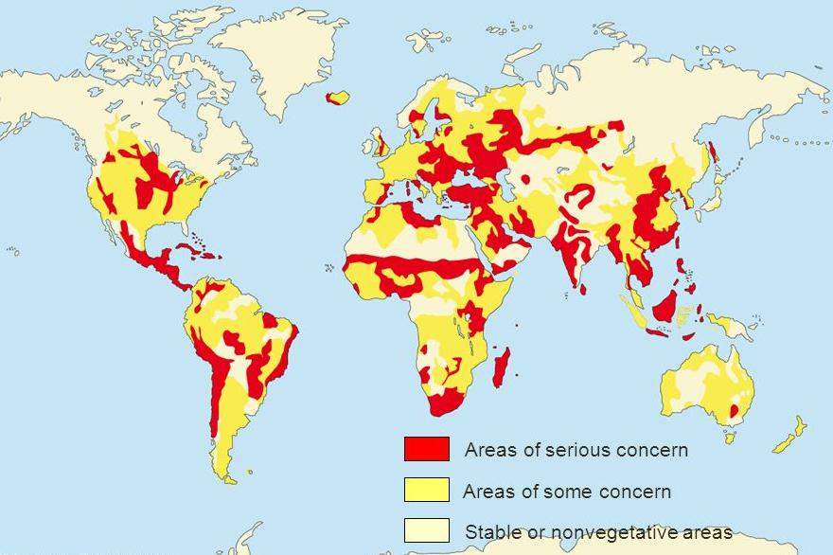
Soil Erosion

Slide 6
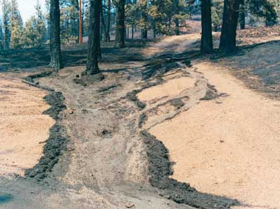
Sheet Wash
Large areas of surface soil are washed away during heaving rain.
Can include landslides

Slide 7
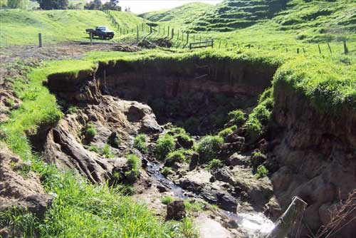
Gullying
Channels develop on hillsides following rainfall.
Over time they get deeper and deeper.

Slide 8
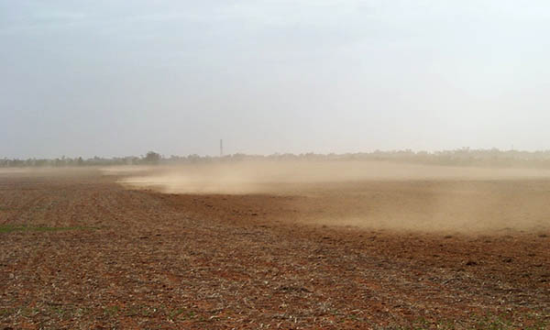
Wind Erosion
Drier soils have the top layers consistently removed.

Slide 9
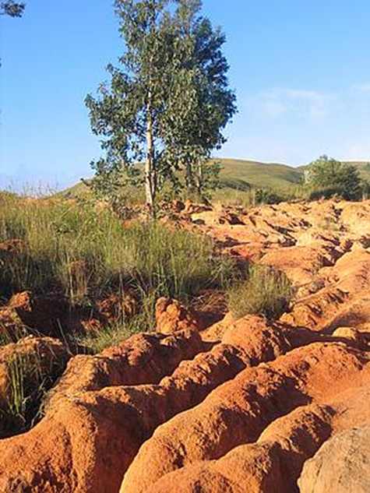
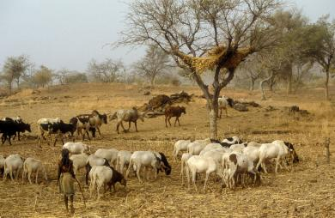
Human activities that lead to soil degradation
Overgrazing
Overcropping
Deforestation
Unsustainable agriculture
Urbanisation

Slide 10
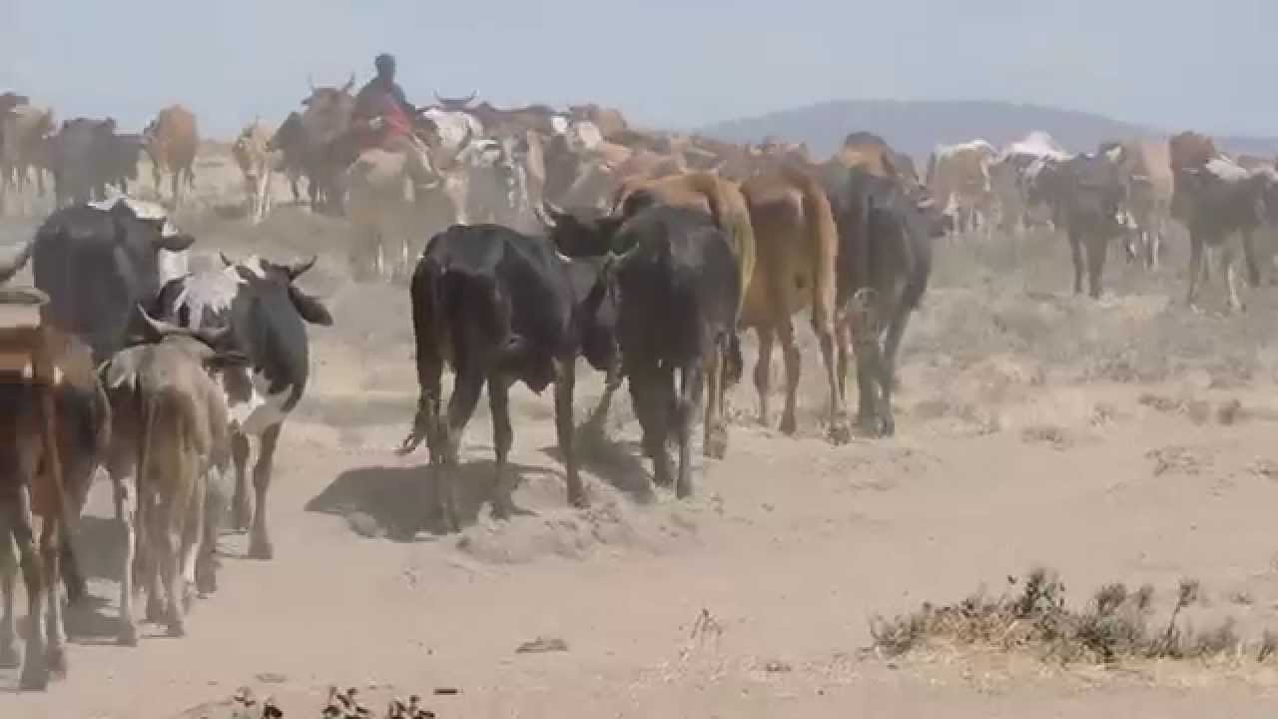
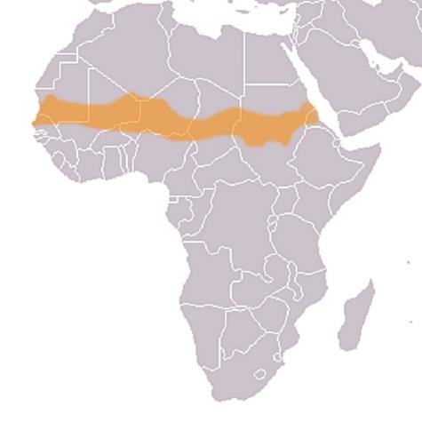
Overgrazing
Too many animals grazing in the same area.
Plants cannot recover.
Leads to bare patches with no plants.
If plants do survive their roots never develop properly.
Case study:
Sahel in Africa (just south of the Sahara)
1970s and 1980s
Wealth determined by the number of cattle a man owns
Lead to very high stocking
Exacerbated by drought
Wind erosion
Cattle died
Mass famine

Slide 11
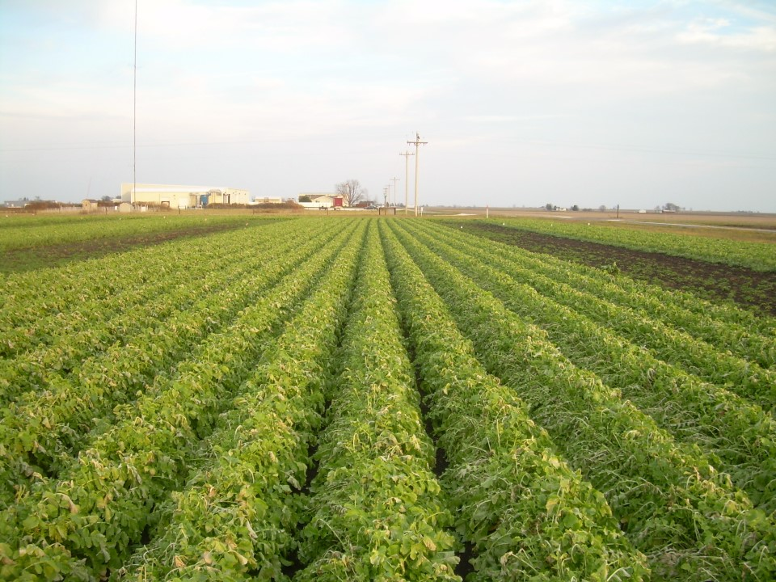
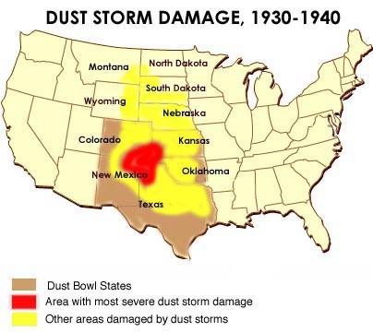
Overcropping
Depletes soil nutrients
Makes the soil friable (dry and susceptible to wind erosion)
Nutrients are not restored
Increased risk of crop failure then wind erosion.
Case study:
“Dust bowl” – 1930s American Mid West
Over use of land
Wind erosion
Soil and dust moved many thousands of kilometres

Slide 12
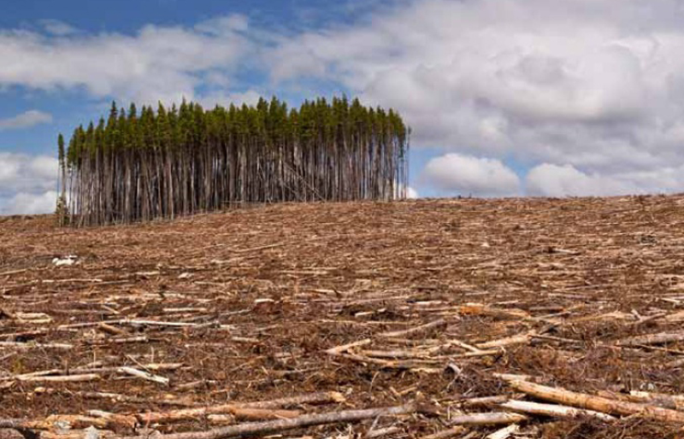
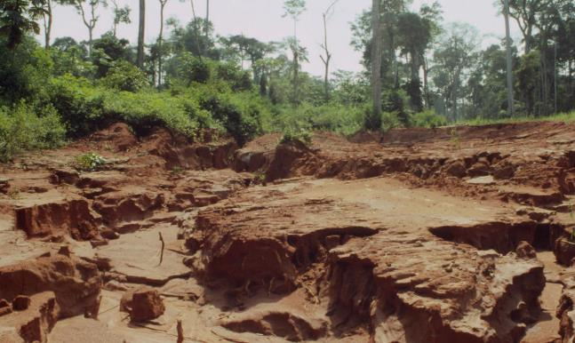
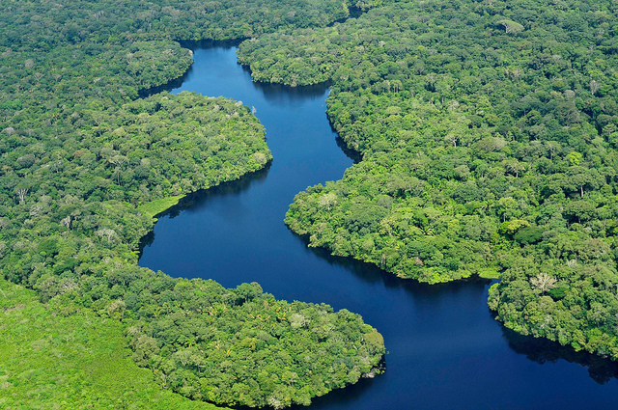
Deforestation
Removal of vegetation leads to exposure of soil.
Tropical rainforests are in areas with very high precipitation.
Massive amounts of water erosion
Leaves slow down rain, roots bind the soil.

Slide 13
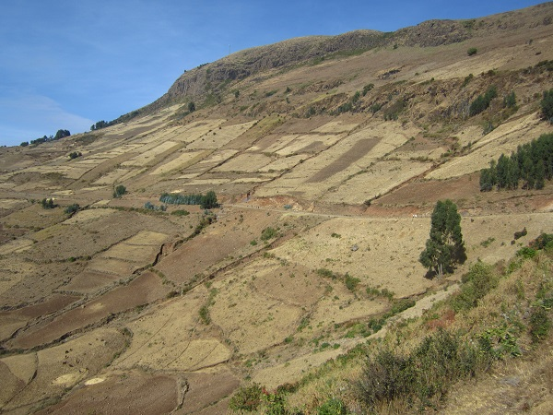
Unsustainable agricultural techniques
Techniques that can be applied over a long period of time without decrease in productivity or increased fertilisers.
Total removal of crops (leaves bare soil).
Growing crops in rows with bare soil in between.
  Especially bad if rows are in the direction of the slope.
Ploughing in the direction of slope makes channels for the water to flow down.

Slide 14
Unsustainable agricultural techniques
Excessive use of pesticides (toxification).
Irrigation – water evaporates leaving behind a hard, salty layer (salinization).
Monocultures mean the same nutrients are depleted.

Slide 15
Unsustainable agricultural techniques

Slide 16

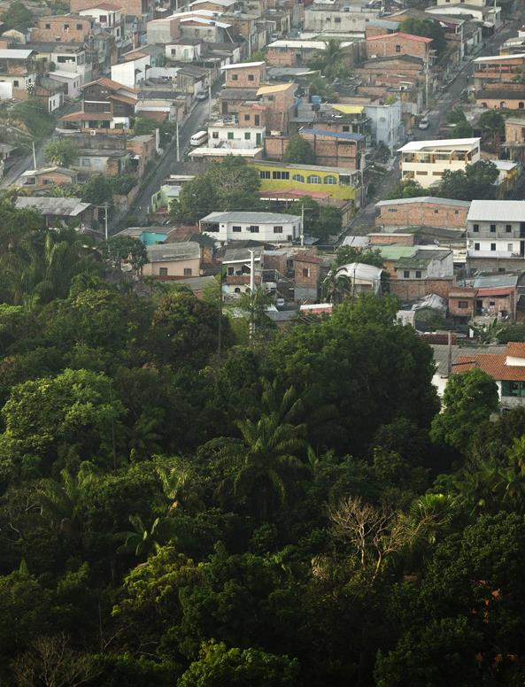
Urbanisation
More people now live in cities than in rural areas.
Increased run off may lead to extra erosion down stream.
Expanding into prime agricultural land.

Slide 17
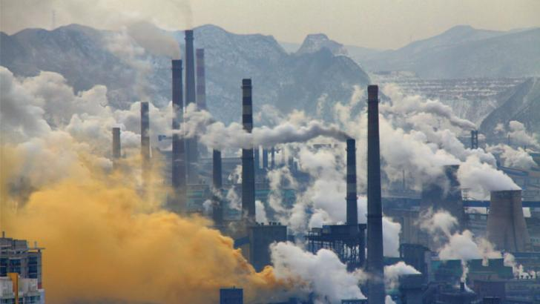
Toxification
Increase soil acidity
Caused by leaching of metals
Burning of plant material increases pH
Coal power plants

Slide 18
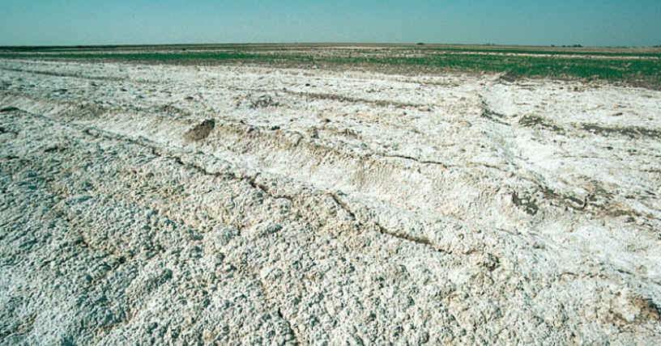
Salinization
Irrigation water contains small amounts of dissolved salts
Evaporation leaves salts behind
Salt builds up in soils.

Slide 19
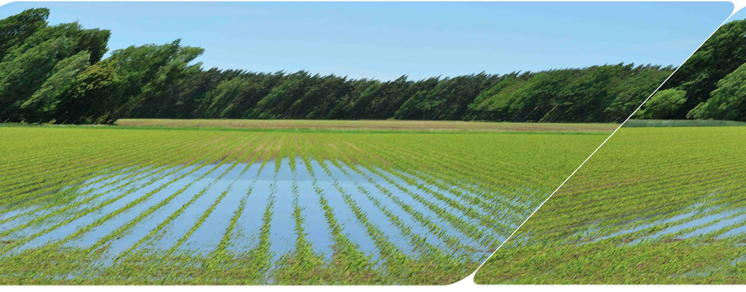
Waterlogging
Precipitation and irrigation water not moving downward
Water table rises
Soil saturated or impermeable

Slide 20
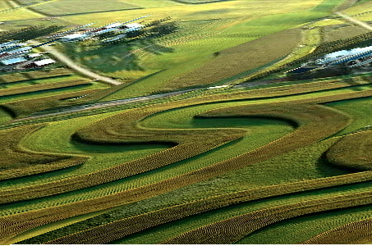
Solutions
Research each of the following:
  Addition of soil conditioners (lime, organic material)
  Wind reduction
  Soil conserving cultivation techniques
    Cover crops, terracing, ploughing, contour farming.
  Improved irrigation (trickle flow)
  Crop rotation

