Slide 1
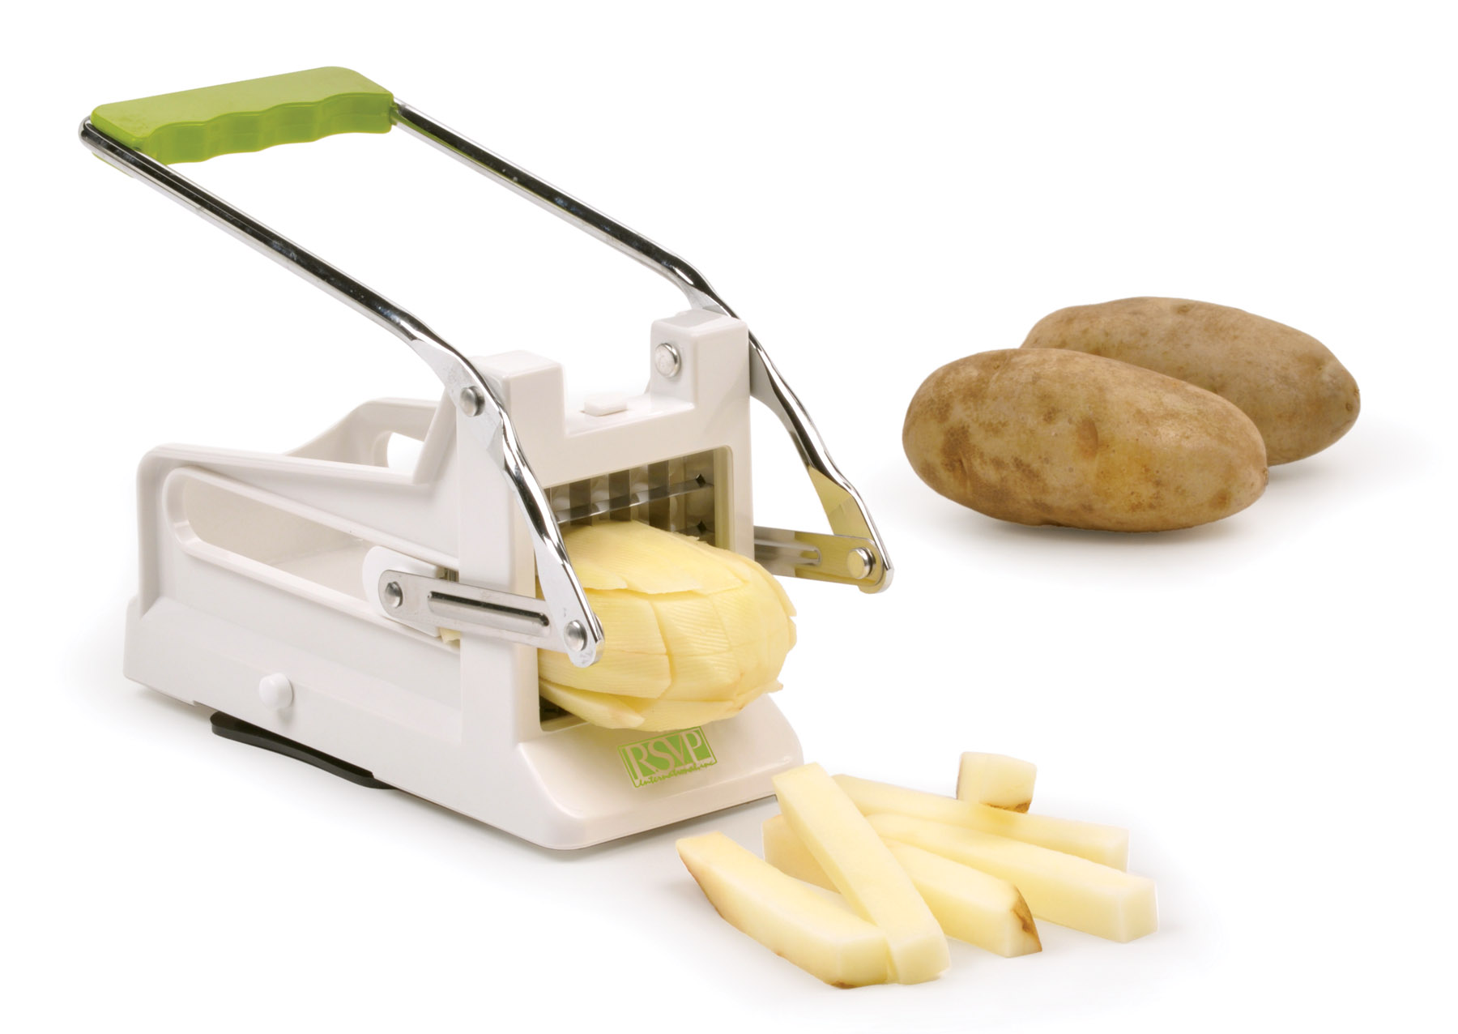
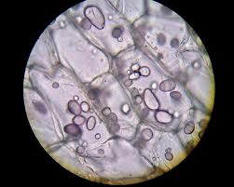
LAB: Using a potato to illustrate cell membrane transport

Slide 2
0.0 osmol/L
0.2 osmol/L
0.4 osmol/L
0.6 osmol/L
0.8 osmol/L
1.0 osmol/L
Notes:
Have students in table groups try to figure out what we will be doing in the lab based on this graphic alone.

Slide 3
Pre-lab: 5-7 minutes
(in lab book)
Use your device to define solute and osmolarity.
Identify the independent variable (IV) and the levels of the IV.
Identify the dependent variable (DV)
Write a problem question.
0.0 osmol/L
0.2 osmol/L
0.4 osmol/L
0.6 osmol/L
0.8 osmol/L
1.0 osmol/L
Notes:
give students time to work
table share out answers
have students discuss the various RV options that arise and pro’s/cons of each.
lead discussion so students settle on RV as % change in mass

Slide 4
Debrief
Solute:
Osmolarity:
IV:
levels of the IV.
IV (and why △)
Problem question

Slide 5
Grab a whiteboard and as a table group, draw what you agree to be the predicted graph for the potato lab results.
Consider:
IV on X axis
DV on Y axis
How will you differentiate an increase in from a decrease in the DV?

Slide 6
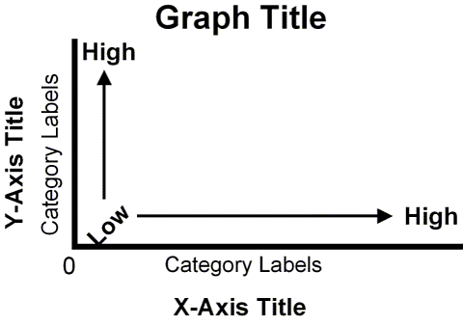
Pre-lab cont...
Create a graph to illustrate your expected results
Write a hypothesis to explain the relationship between the IV and DV.
“If the solution is hypertonic to the potato, then the mass will… because…”
“If the solution is isotonic to the potato, then the mass will… because…”
“If the solution is hypotonic to the potato, then the mass will… because…”

Slide 7
Are the following controlled variables?
Using the same size beaker?
Having consistent room temperature?
Stirring all solutions equally?
Using the same potato source?
Keeping the potato the same size and shape?
Using the same gram scale for all measurements?

Slide 8
Validity Measures vs.
Controlled Variables
COMMON STUDENT MISCONCEPTION…
Good Lab Practices
Using consistency in tools or lab technique to ensure measurements are consistent across trials
Controlled Variable
A variable that might impact the responding variable if not held constant
Notes:
ask for examples

Slide 9
Pre-lab cont...
Identify three good lab practices
Create a table that:
lists three controlled variables
explains why each variable must be controlled
explains how each variable can be controlled

Slide 10
INITIAL DATA TABLE SETUP
Your group will collect data for 1 trial of all 6 levels of the IV.
What data do you need to measure?
What is the unit of the data?
What is the measurement uncertainty for your measurements?
mass
volume
time

Slide 11
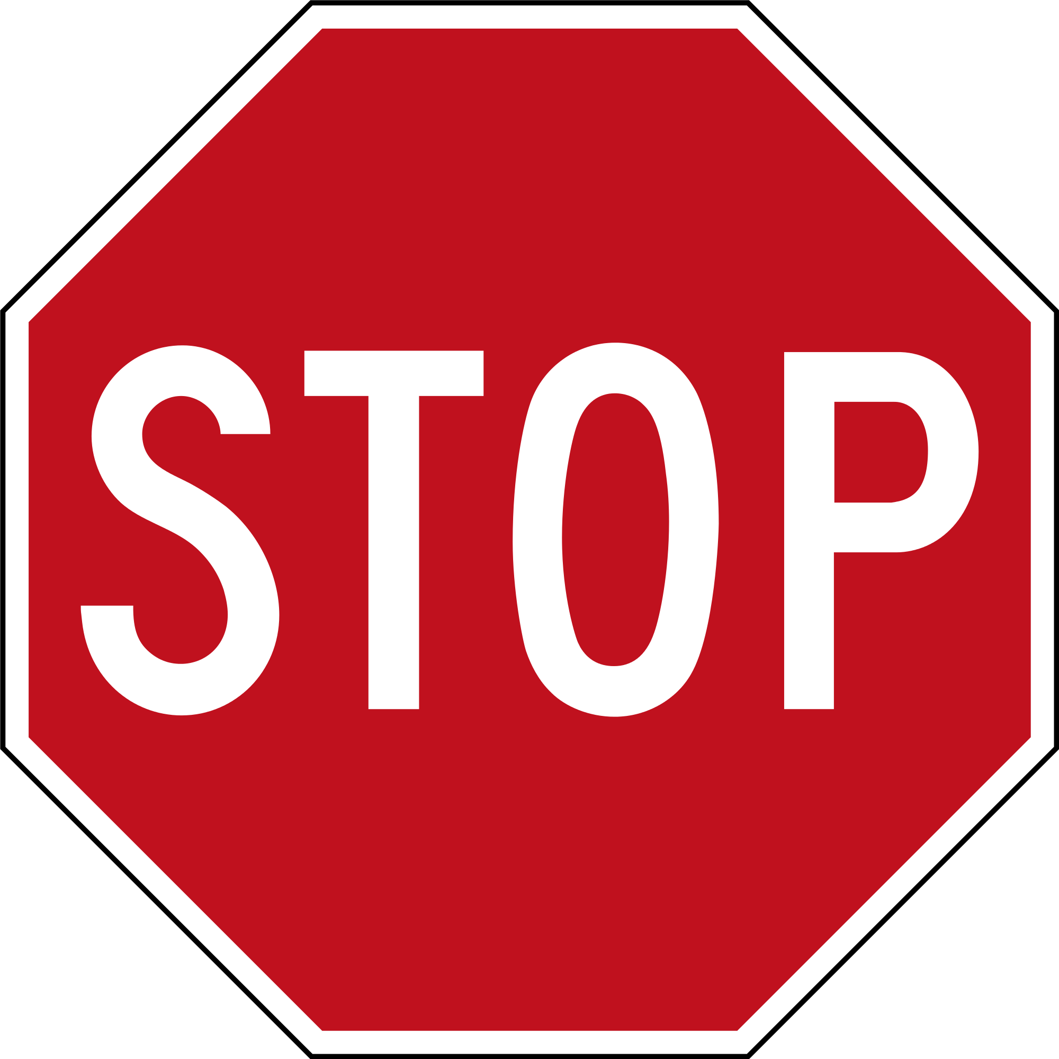
Stop pre-lab

Slide 12
Day 1
Your group will collect data for 1 trial of all 6 levels of the IV.

Slide 13
Day 2
Collect your final data
Calculate % change of mass for each potato
Have ONE group member submit your results for class data via the online form
% change = final mass - initial mass
initial mass
X 100

Slide 14
Analysis
Calculate mean percent change for class data (show worked example for one level)
In lab book, graph mean percent change results (use at least a half page). Be sure to use the right type of graph!

Slide 15
Determining Osmolarity
Create a line of best fit on the graph to show the trend in the % change of mass.
Use the graph to estimate the molarity of the potato. Highlight your estimate in your lab book.

Slide 16
Stop Analysis pt1

Slide 17
Standard Deviation
Compare your standard deviation calculations with others at your table group. Everyone should have the same number!
Add the standard deviations to your graph by drawings lines up (+1SD) and down (-1SD) from each point in the graph.

Slide 18
Graphing in Excel
Attempt an Excel graph with error bars
Follow these directions
Come tomorrow with a printed version in lab book
DO NOT just print someone else’s version. You need to learn how to do this.

Slide 19
Analysis Questions
Determination of osmolarity of the potato.
Explain how you determined the potato osmolarity.
Explain what why there is a positive % change in mass in some solutions.
Explain what why there is a negative % change in mass in some solutions.
Explain what the standard deviation of each level represents.

