Slide 1
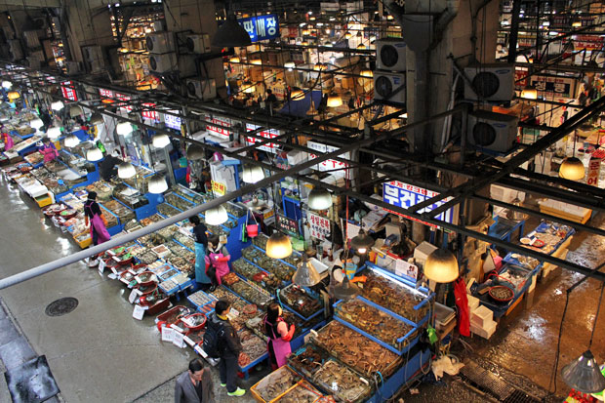
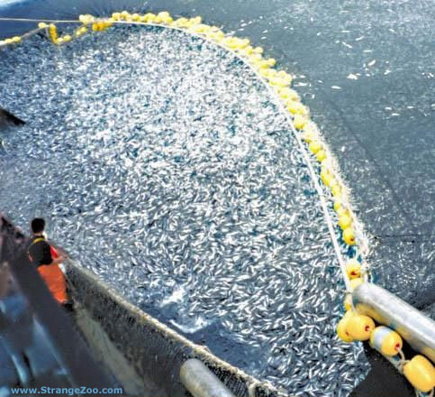
Topic 4.3: Aquatic food production systems
Starter:
Create a spider diagram with everything you currently know about fisheries and fishing

Slide 2
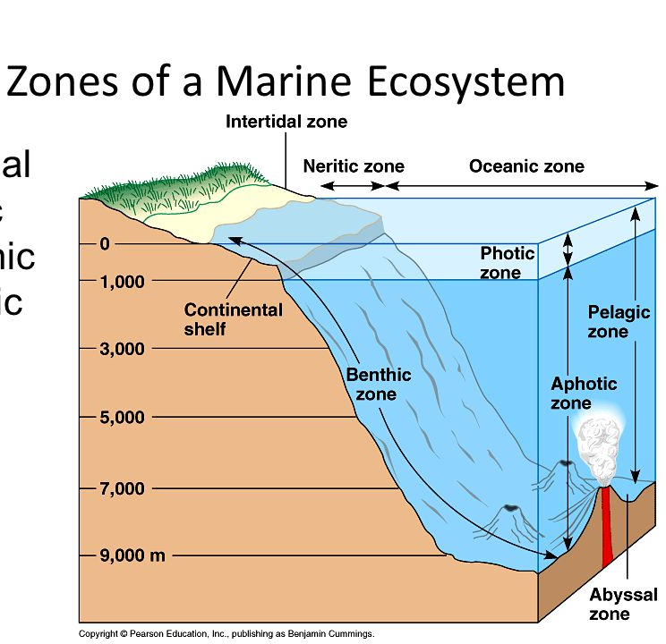
Marine Ecosystems and Food Webs
Include
Intertidal zone
Mangroves
Estuaries
Lagoons
Coral reefs
Deep oceans

Slide 3
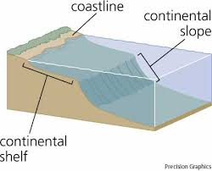
Marine Ecosystems and Food Webs
Continental Shelf – 50% of marine productivity
Upwelling increases nutrients in water
Shallow so light can penetrate
Near coast so countries claim rights
Deep Ocean – low productivity and does not belong to specific country

Slide 4
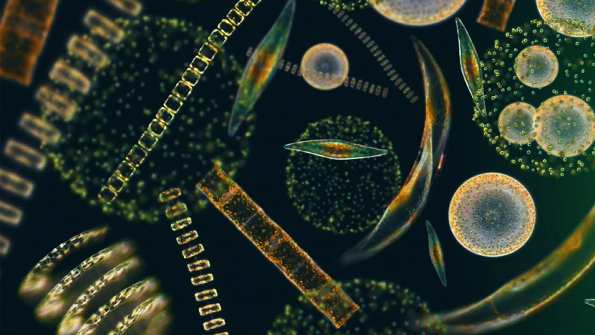
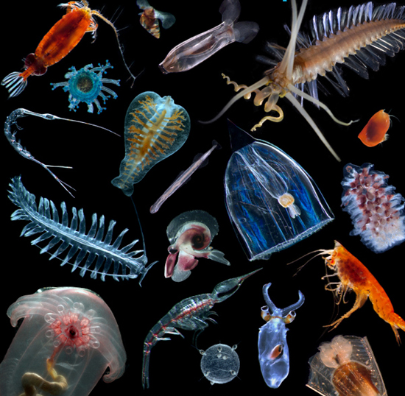
How does energy get into aquatic food webs?
Phytoplankton - 99% of primary productivity in the oceans
Zooplankton - eat phytoplankton and their waste

Slide 5
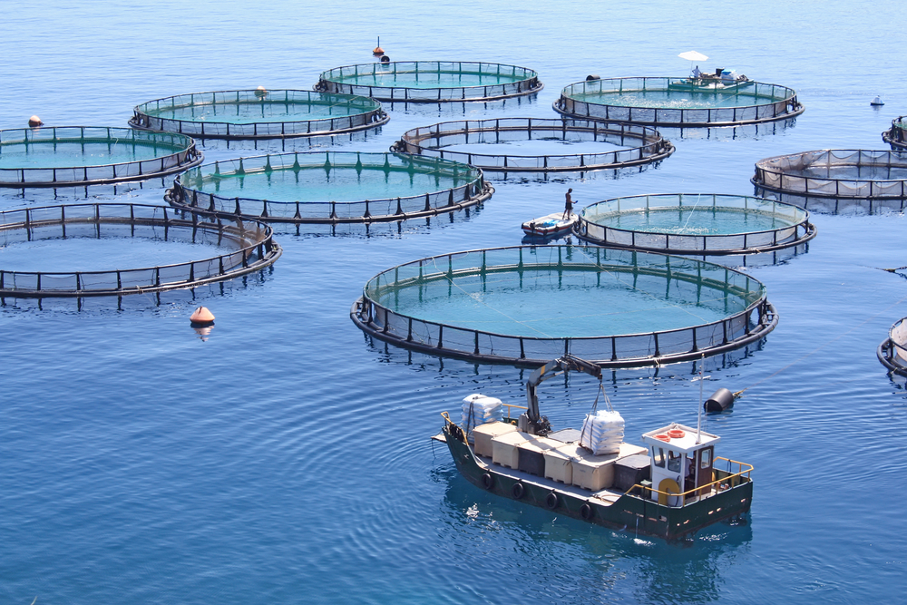
Fisheries
Place where fish are caught/harvested
Capture fisheries = wild fisheries
Aquaculture = farm fisheries
www.garwareropes.com

Slide 6
Fisheries
Include any harvesting of fish, both capturing and aquaculture
90% of fishery activity occurs in oceans
Fish are important food sources for humans
More that 70% of world’s fisheries are exploited
Many people in MEDC are decreasing meat intake and increasing fish consumption
Farmed fish is becoming as common as wild caught fish

Slide 7
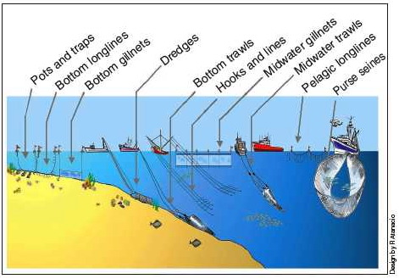
Methods of Fishing
Some commercial methods of fishing are not sustainable
Dredging – drags a metal bag across the ocean floor
Gillnets – a curtain of netting is placed in the water with holes large enough for the fish’s head but not body
Trawling – drags a net through the water behind a boat
Blast Fishing – using explosives

Slide 8
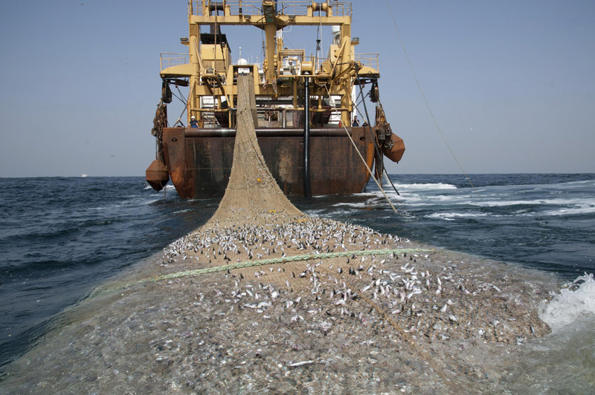
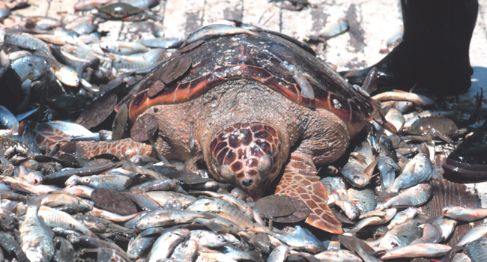
We have got much better at catching fish.
Trawler nets are incredibly efficient at sweeping the sea. They capture pretty much all life in their path.
Huge amount of bycatch.
Damage sea floor and wipe out entire habitats/ecosystems.

Slide 9
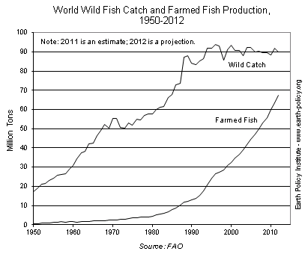
Demand for fish and seafood is continually increasing as human population grows and diet changes.

Slide 10
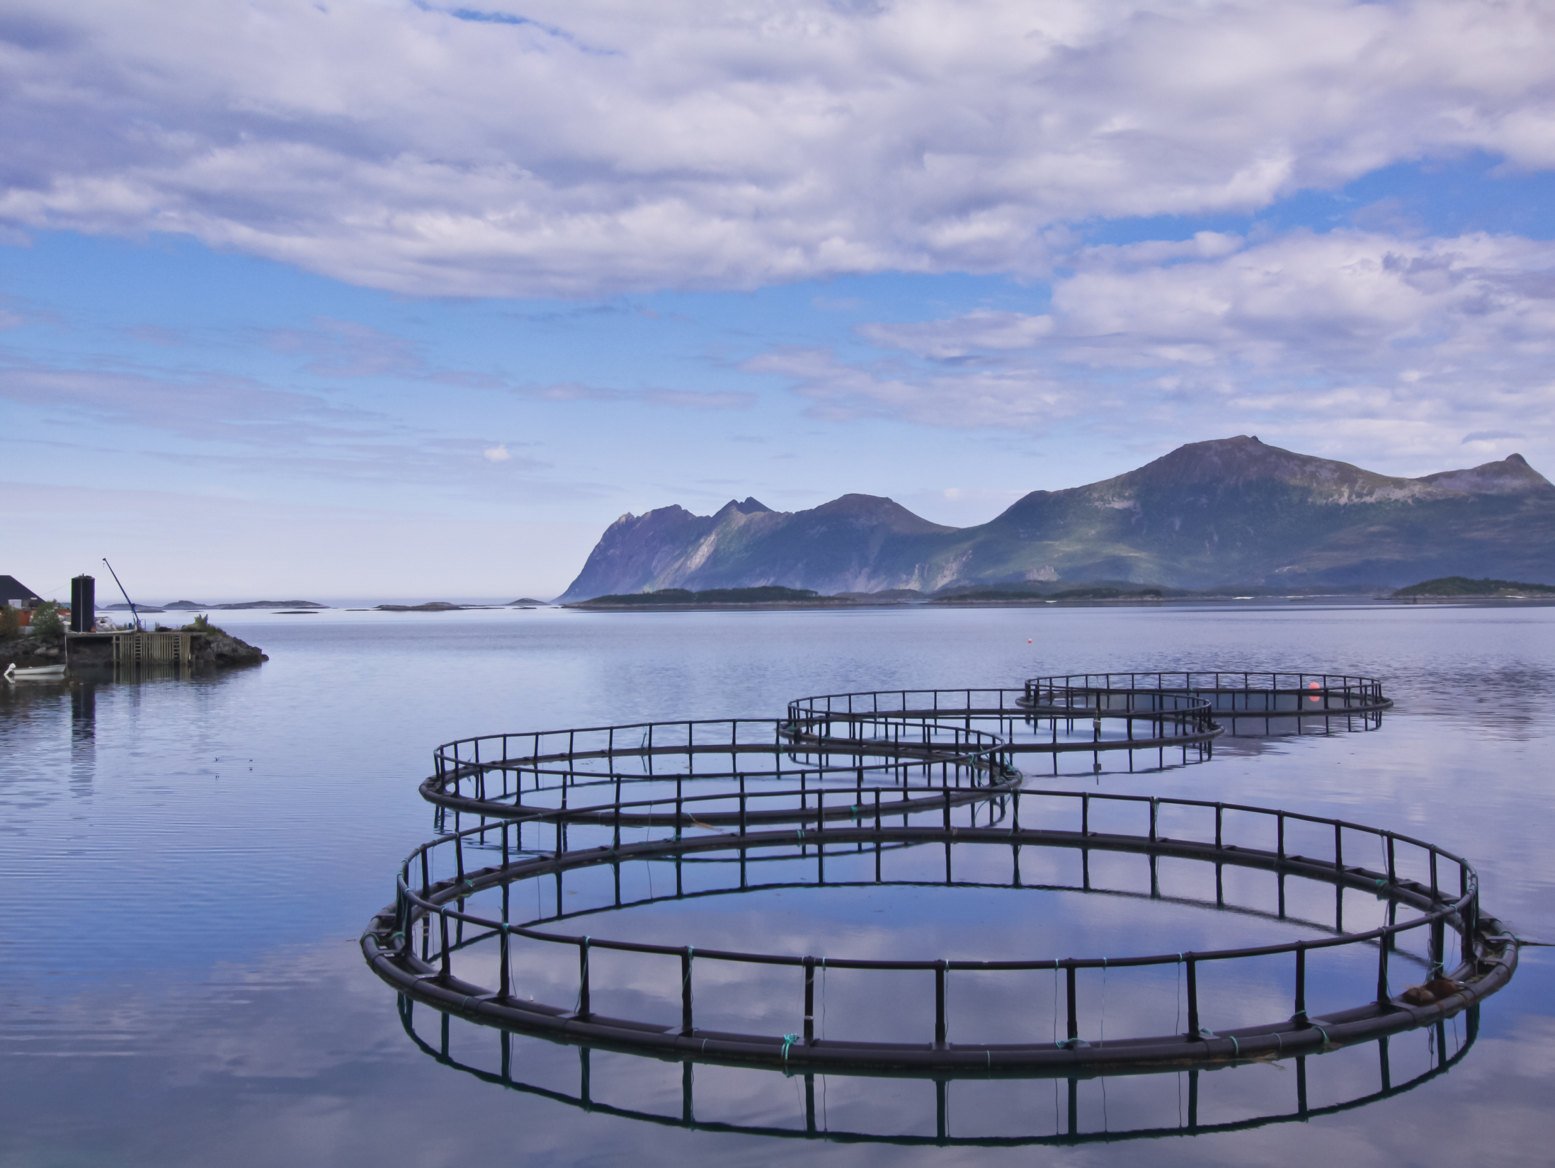
Aquaculture - Benefits
Fish Farming is becoming more sustainable due to
Fishmeal using scraps that we wanted in the past
Waste products from livestock and poultry industry are being used instead of fishmeal
Many carnivorous fish species are able to obtain enough nutrients from other sources instead of eating other fish
China uses carp and catfish which grow in rice paddy fields. These fish add nutrients to the water which act as a fertilizer for the rice

Slide 11
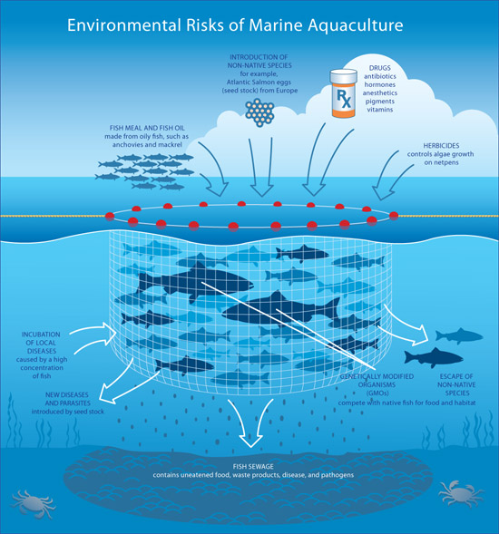
So why not just farm fish?
Loss of habitat
Pollution (food, antibiotics and other medicines)
Spread of disease
Escaped individuals:
GMO
Outcompete native species
Some species just not suited to being farmed
May increase competition with native species

Slide 12
Governance of the Ocean
UN Convention of the Laws of the Sea (UNCLOS) – 1982
Continental shelves belong to the country which the arise
200 nautical mile limit from the low water to the shore for a country that exclusively belongs to that country for economical use
Outside these areas is known as international waters and is controlled by no country

Slide 13
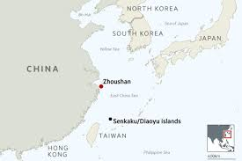
International Conflict
Cod wars – series of disputes between Britain and Iceland from 195s to 1970s
Turbot was between Canada and Spain in 1995
India and Sri Lank in 2012
This year China has increased their fishing fleet creating conflicts with Indonesia, Philippines, Korea and Russia

Slide 14
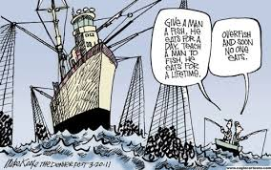
Tragedy of the Commons
Conflict between individual need and the common good of society
If resource is seen as belonging to all, we tend to overuse and exploit it
Oceans, lakes and rivers tend to be good examples of the tragedy of the commons

Slide 15
Tragedy of the Commons Activity
Conflict between individual need and the common good of society
If resource is seen as belonging to all, we tend to overuse and exploit
Oceans, lakes and rivers tend to be good examples of the tragedy of the commons

Slide 16
Maximum Sustainable Yield (MSY)
Sustainable Yield: The amount of natural capital that can be extracted each year without depleting the stock to a point it is not replenishable
Maximum sustainable yield (MSY): The largest yield or catch that can theoretically be taken from a species’ stock without permanently depleting the stock. (The maximum catch that will allow the population to return to carrying capactiy as quickly as possible)
Generally MSY is about ½ the carrying capacity

Slide 17
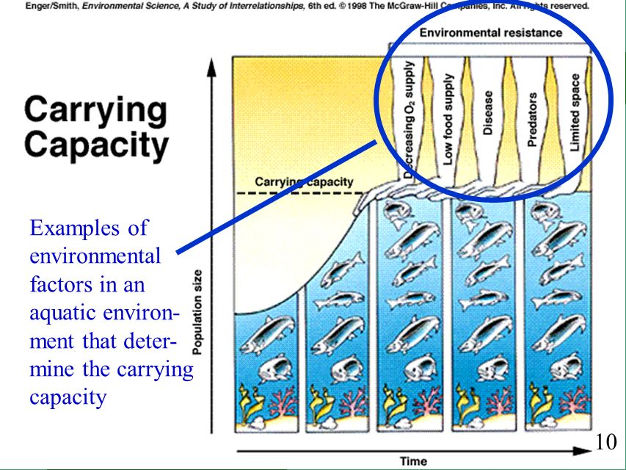
Maximum Sustainable Yield (MSY)
Carrying Capacity (K) is depended on
Reproductive strategy
Lifespan of organism
Limiting factors in ecosystem

Slide 18
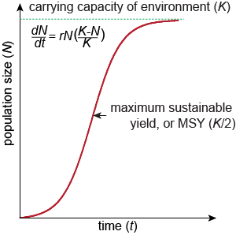
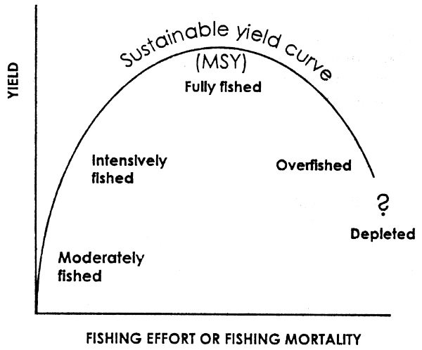
Maximum sustainable yield
Calculating MSY is difficult as it is hard to determine the actual carrying capacity
Must look at the annual growth in a population
MSY is obtained if the population size remains the same

Slide 19
Maximum sustainable yield
The amount we can take out without reducing the original stock.
i.e. If 1000 fish are born every year, we only take 1000 fish.

Slide 20
Maximum sustainable yield
SY = annual growth and recruitment – annual death and emigration
SY = $\frac{total biomass at t+1}{energy} − \frac{total biomass at time t}{energy}$
In practice harvesting at the MSY is not sustainable:
Imprecise calculations based on models
Estimates based on previous experiences (no two situations are the same)
Does not allow for the dynamic nature of the harvest (age and gender ratio)
Disease can hit populations

Slide 21
Maximum Sustainable Yield
Generally harvesting at the MSY results in a decline in the population due to
Normal population dynamics
Difficulty in measuring the actual population
Harvest does not take into account age/health or gender
Does not account for disease or other natural factors
Harvesting at MSY is NOT sustainable
Optimal Sustainable Yield is a safer approached because it is based on mass of catch rather that number of fish

